Slide 1

WAY TO ENTERPRISE
Java Basics
VTI ACADEMY
Author: duy.nguyenngoc1@vti.com.vn
March 2020

Slide 2
Agenda
Common Error
Fix bug
Copyright © VTI Academy All Rights Reserved

Slide 3
Common Error
NullPointerException
Import wrong library
Không comment

Slide 4
Fix bug
Debug
Stacktrace

Slide 5
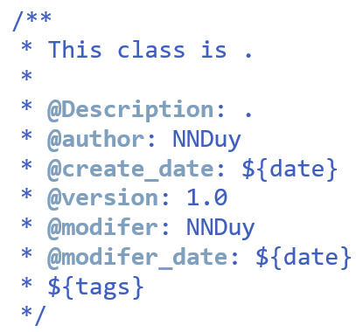
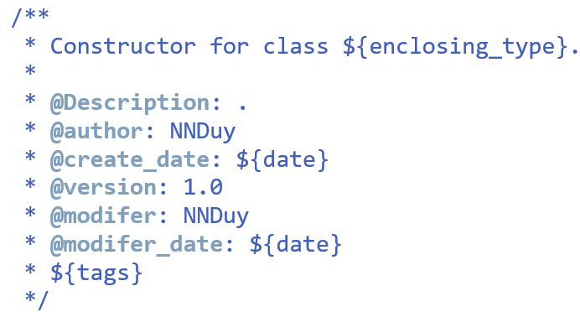
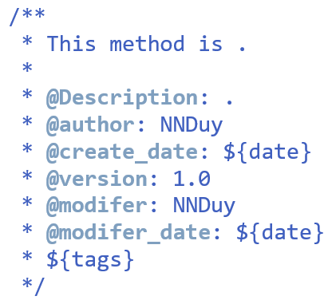
Comment template
Window → Preferences → Java → code Style → Code Templates
Shortcut: Alt + shift + j

Slide 6
Assignments 1

Slide 7
Assignments 2
Assignment for Testing System

Slide 8
Q & A
Copyright © VTI Academy All Rights Reserved

